Slide 1
PATCH
DIGITAL IMAGE PROCESSING
MATCH
ESWAR(2023102011)
YASWANTH(2022102051)

Slide 2
Introduction
Problem statement
Advancements in digital photography enable image
manipulation using patch-based techniques like
retargeting and completion, however there are
computational challenges.
PatchMatch
PatchMatch accelerates nearest-neighbor search for
image patches, enabling efficient in-painting, retargeting,
and reshuffling, widely used in Adobe tools (Content-
Aware Fill feature)

Slide 3
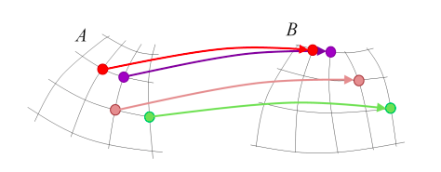
PatchMatch at a glance
What PatchMatch computes: dense Nearest Neighbour Field (NNF).
Core idea: propagation + random search → very fast nearest-patch search.
Why useful: in-painting, retargeting, reshuffling.

Slide 4
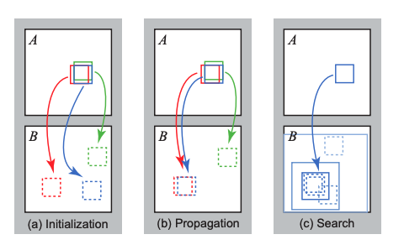
NNF ALGORITHM
1. INITIALIZATION
The algorithm initializes by randomizing coordinates or
using prior information, refining correspondences
progressively for in-painting and similar applications.
2. PROPAGATION
Propagation transfers good offset estimates to
neighboring patches, leveraging local coherence,
minimizing error, and alternating forward-reverse scans
for refinement.
3. RANDOM SEARCH
Random search refines offsets by exploring nearby
variations, reducing search radius exponentially until sub-
pixel precision ensures optimal matching.

Slide 5
In-painting pipeline (coarse-to-fine + EM)
1. INITIALISATION
PatchMatch begins by initializing the image, mask, patch size, and iteration parameters needed for in-painting.
A binary mask specifies the missing regions where patch synthesis must occur.
An image pyramid (coarse-to-fine) enables global structure restoration at low resolution and detail refinement at higher resolutions.

Slide 6
In-painting pipeline (coarse-to-fine + EM)
2. PYRAMID CONSTRUCTION
The image and mask are progressively downsampled until the smallest level roughly matches the patch size.
Gaussian smoothing with a custom kernel reduces noise and ensures smooth transitions between pyramid levels.
Missing mask regions are propagated across scales using weighted averaging for consistent hole representation

Slide 7
In-painting pipeline (coarse-to-fine + EM)
3. EM OPTIMIZATION
E–Step
Nearby matching patches cast weighted “votes” for filling missing pixels.
The weight for each patch is computed as:
M–Step
Pixel values in the missing region are updated by averaging the weighted votes

Slide 8
In-painting pipeline (coarse-to-fine + EM)
4. MULTI-SCALE COARSE-TO-FINE REFINEMENT
PatchMatch initialization begins at the coarsest pyramid level, where missing regions are first estimated.
Intermediate results are upsampled using bilinear interpolation to maintain smooth transitions between scales.
The NNF (Nearest Neighbour Field) computed at coarse levels is propagated upward to finer resolutions.
This coarse-to-fine propagation reduces computation while preserving structural and visual consistency across levels.

Slide 9
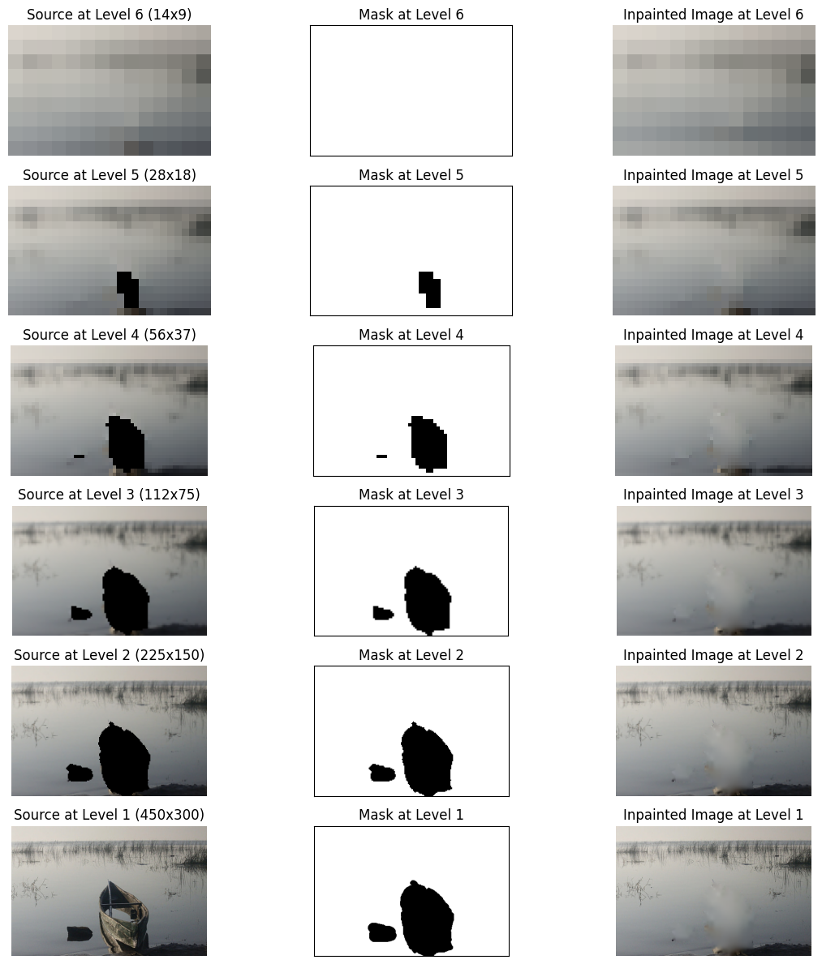
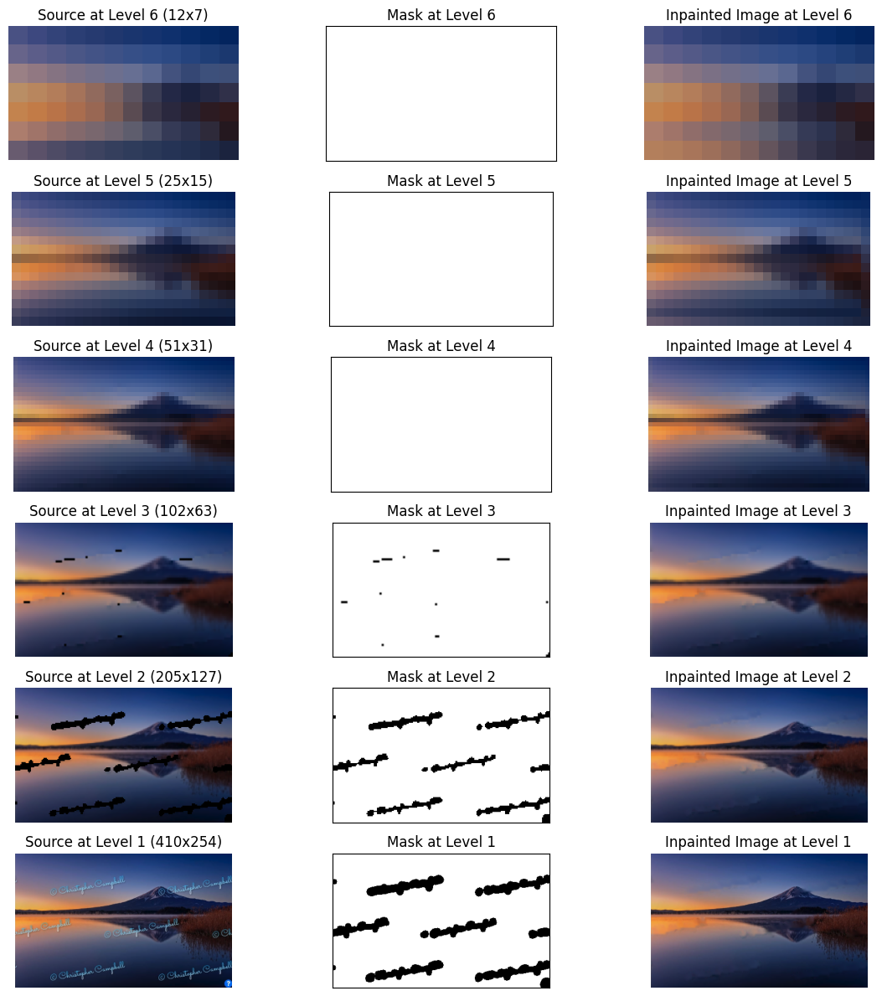
In-painting Boat removal and watermark removal

Slide 10
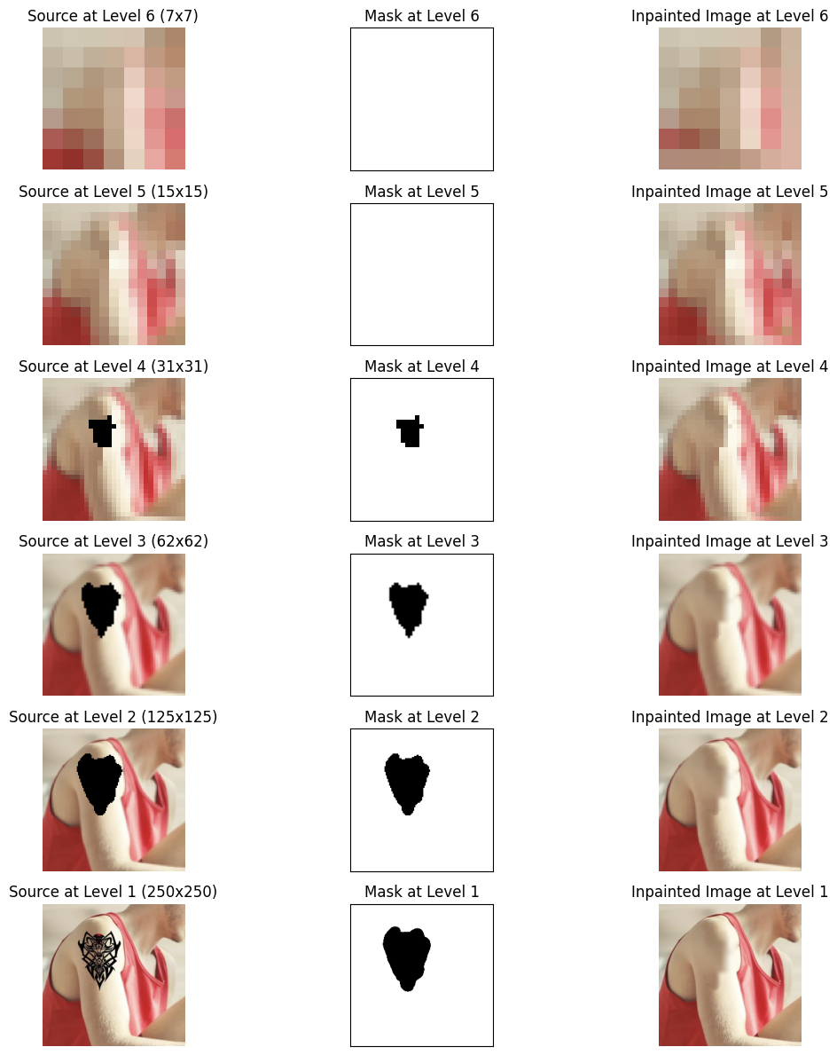
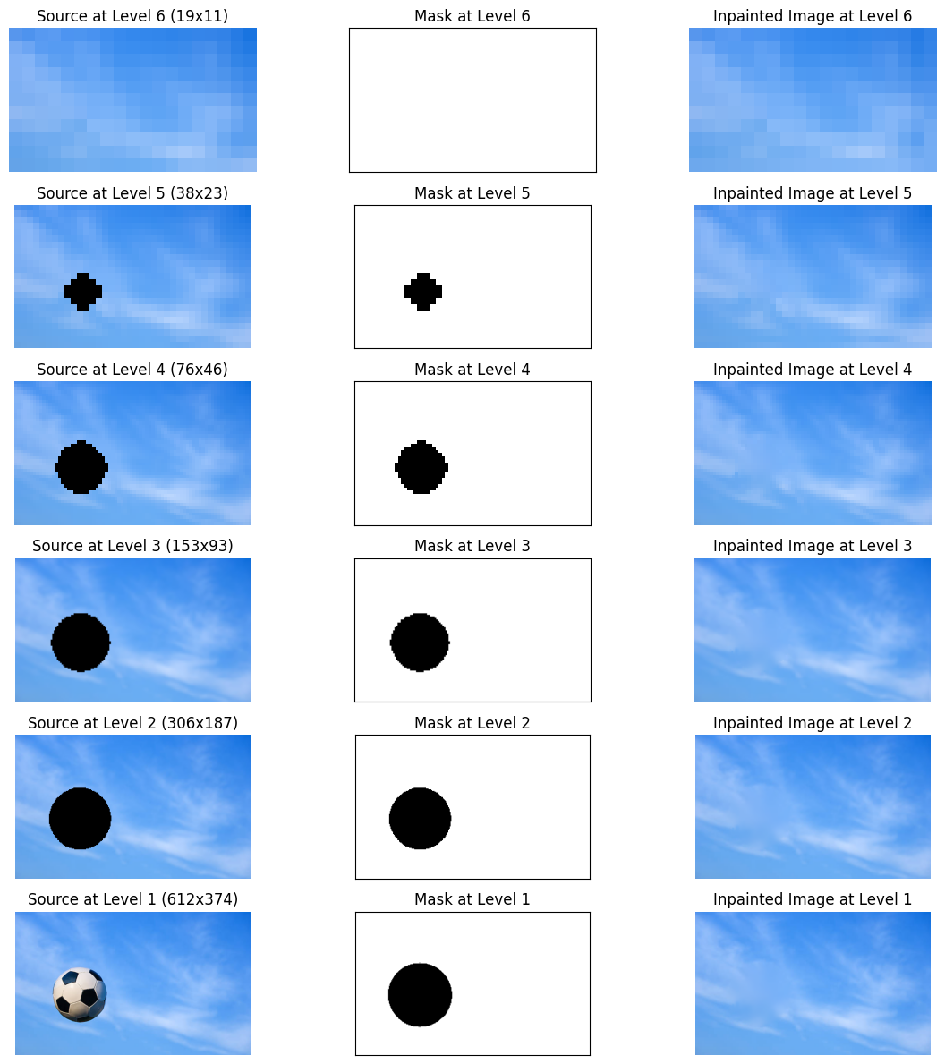
In-painting tatt00 removal and object removal

Slide 11
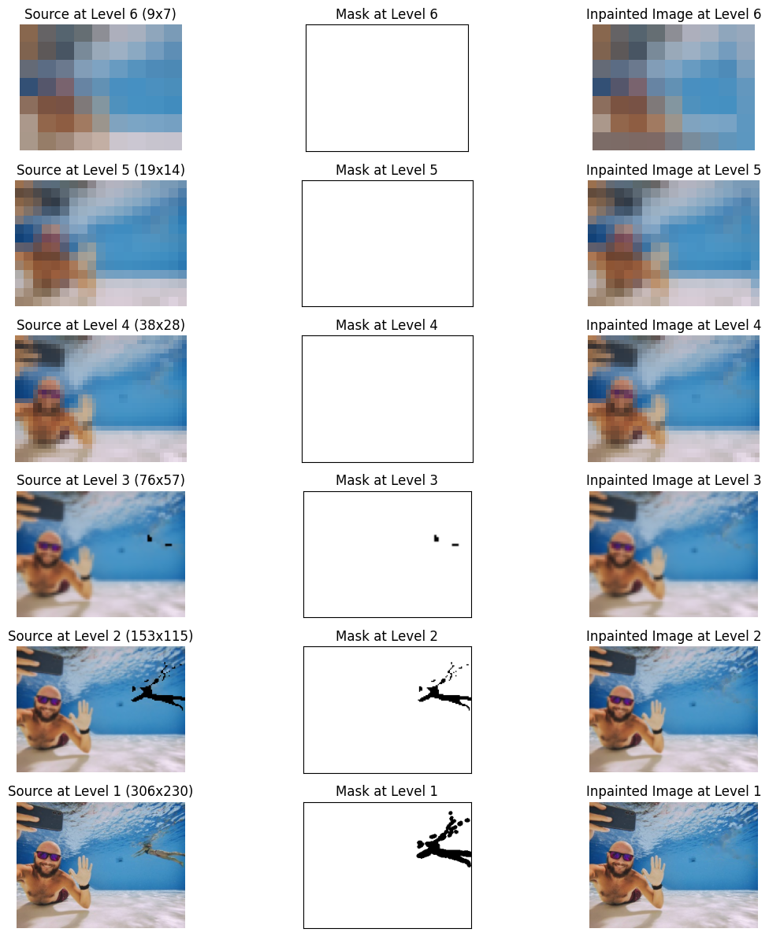
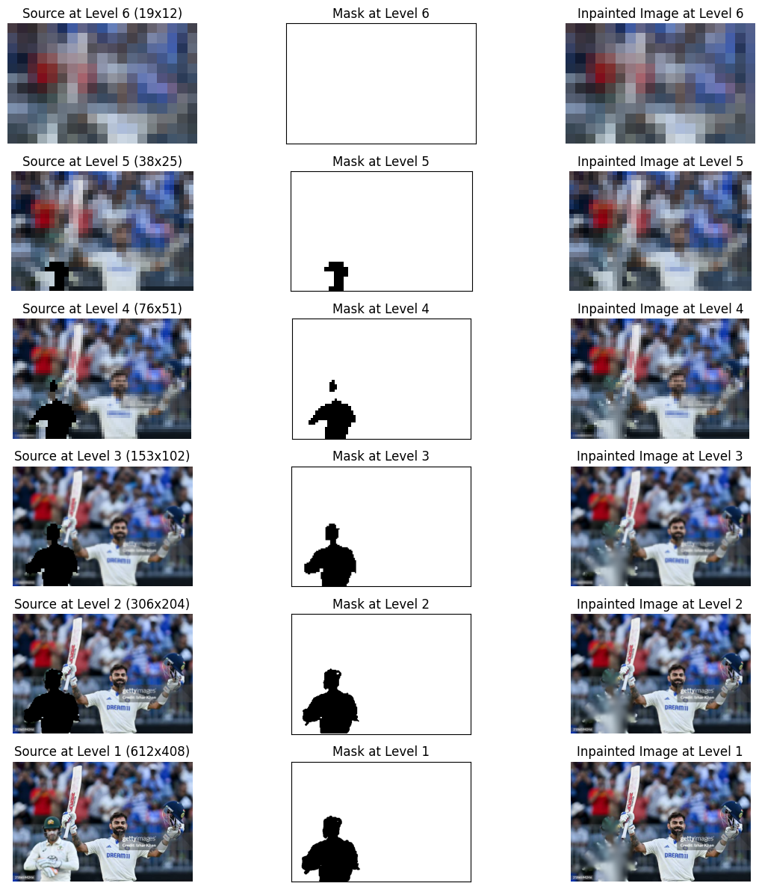
In-painting photo bomb and MAN removal

Slide 12
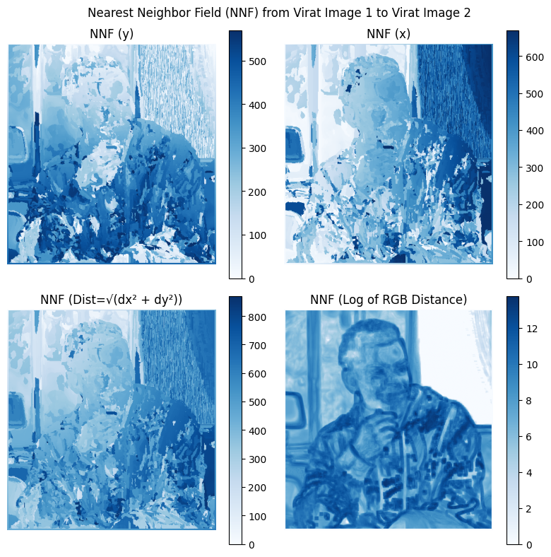
Nnf results
1. NNF(y) represents the pixel distance difference along the y axis
2. NNF(x) represents the pixel distance difference along the x axis
3. The NNF(Dist) represents the magnitude of distance combining NNF(x) and NNF(y)
4. The NNF(RGB dist)
represents the pixel intensity difference between each patch in A and B

Slide 13
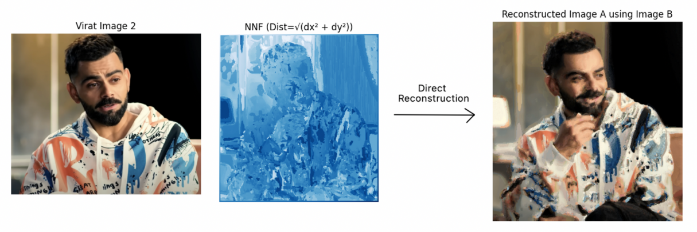
Nnf reconstruction(method-1)
By directly replacing the pixel value with the centre of the NNF patch in B​

Slide 14
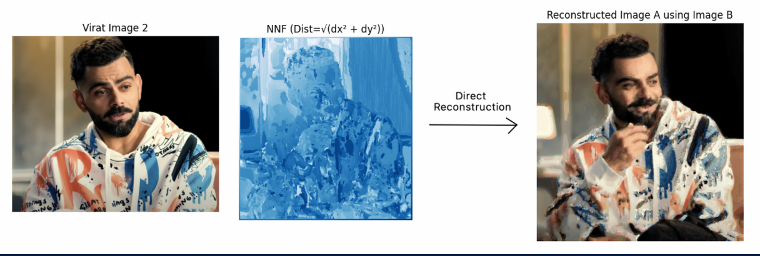
Nnf reconstruction(method-2)
By replacing patches for each pixel centre and averaging the pixel intensities over all
overlapping patches

Slide 15
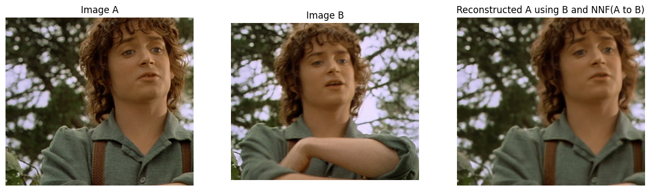
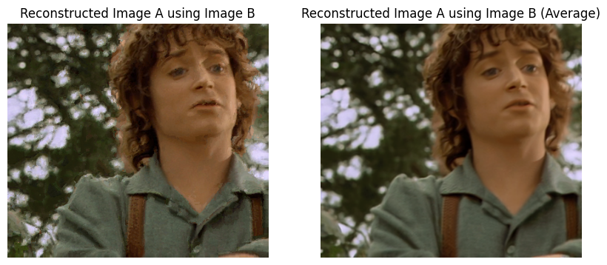
Nnf reconstruction(both methods)

Slide 16
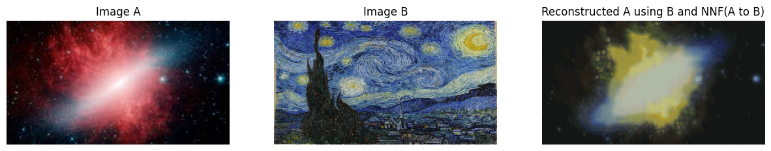
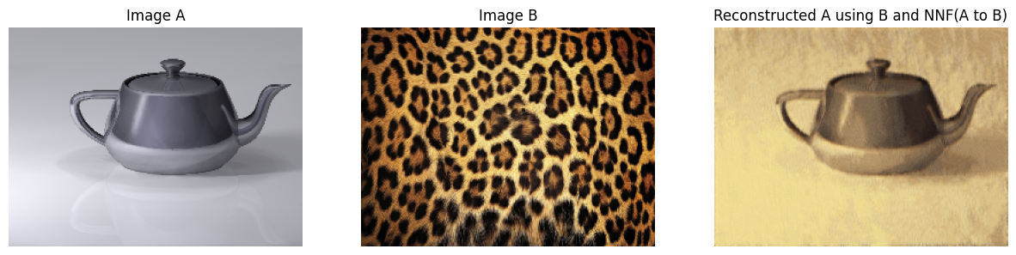
Artistic Style Transfer
Texture Swapping

Slide 17
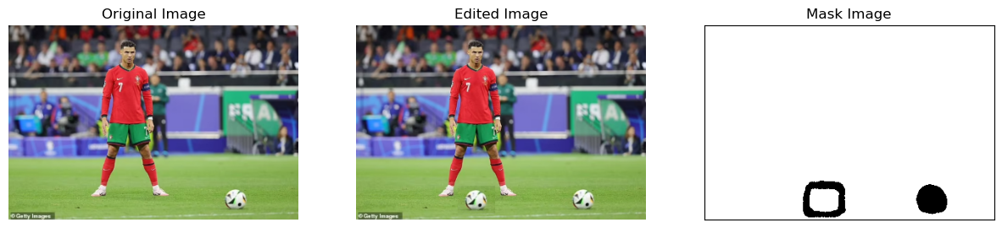
IMAGE RESHUFFLING
To reshuffle an image, copy the desired portion, paste it, apply a mask to remove the original object, and smooth edges.

Slide 18
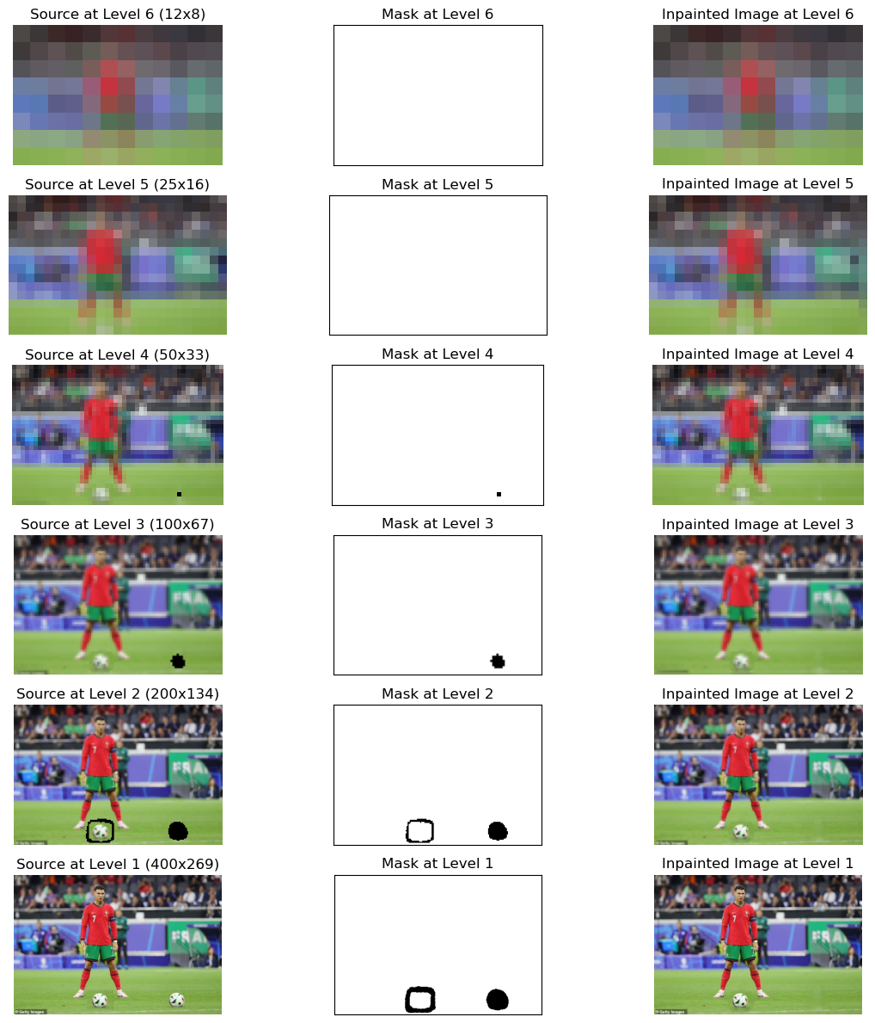
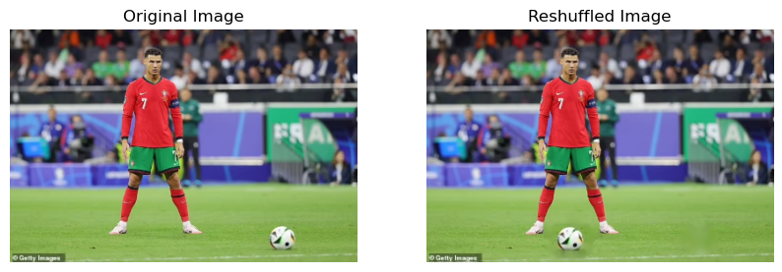
IMAGE RESHUFFLING

Slide 19
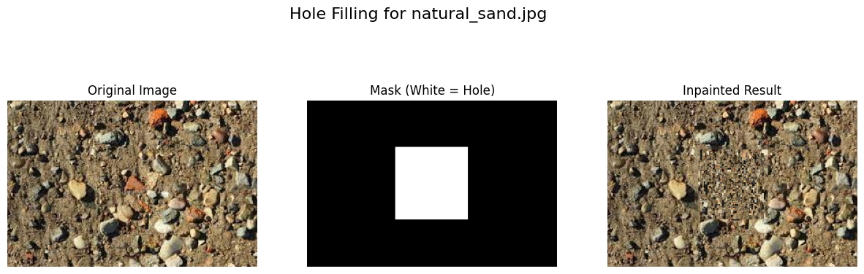
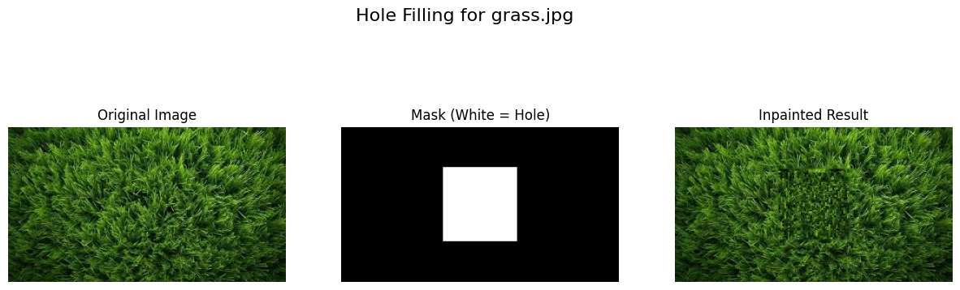
Hole filling

Slide 20
ABLATION STUDY
We compare the the effectiveness of the propagate and random search steps in the NNF computation for the task of image in-painting.
The three cases we test are:
a. Both Propagate and Random Search
b. Only Random Search (No propagate)
c. Only Propagate (No random search)

Slide 21
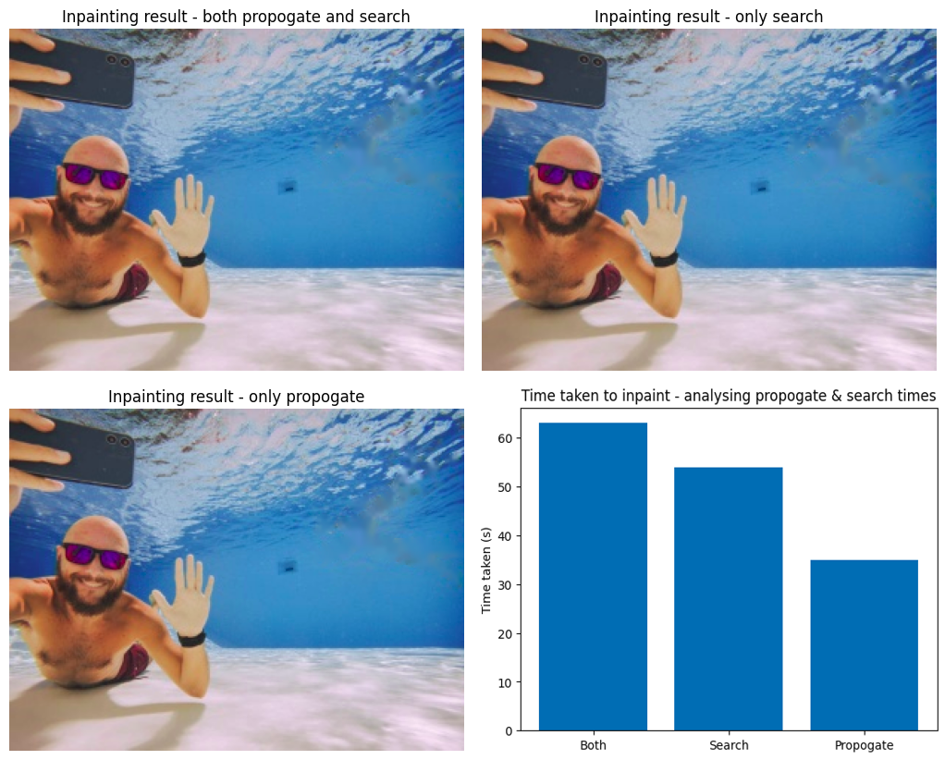
ABLATION STUDY
The three output images show only minor visual differences, meaning both Propagation and Random Search work well independently.
Propagation alone is fastest (35s), outperforming Random Search (54s) and the combined method (63s).
Removing Random Search provides efficient, high-quality results while significantly reducing overall runtime.

Slide 22
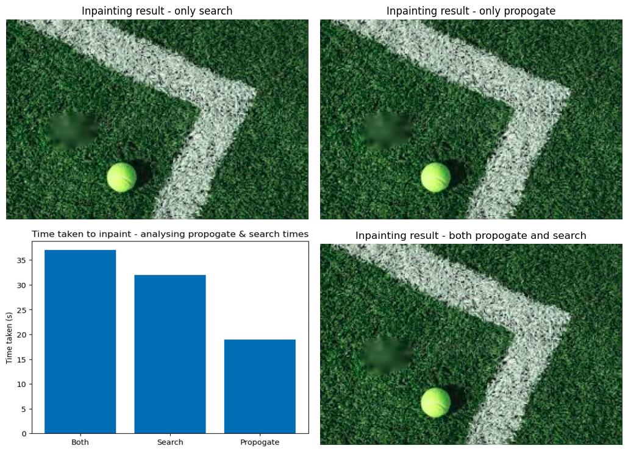
ABLATION STUDY
Testing another image confirms the
hypothesis - Propagate alone delivers
similar results while being the fastest
option, outperforming Random Search
and the combined approach in terms of
runtime efficiency

Slide 23
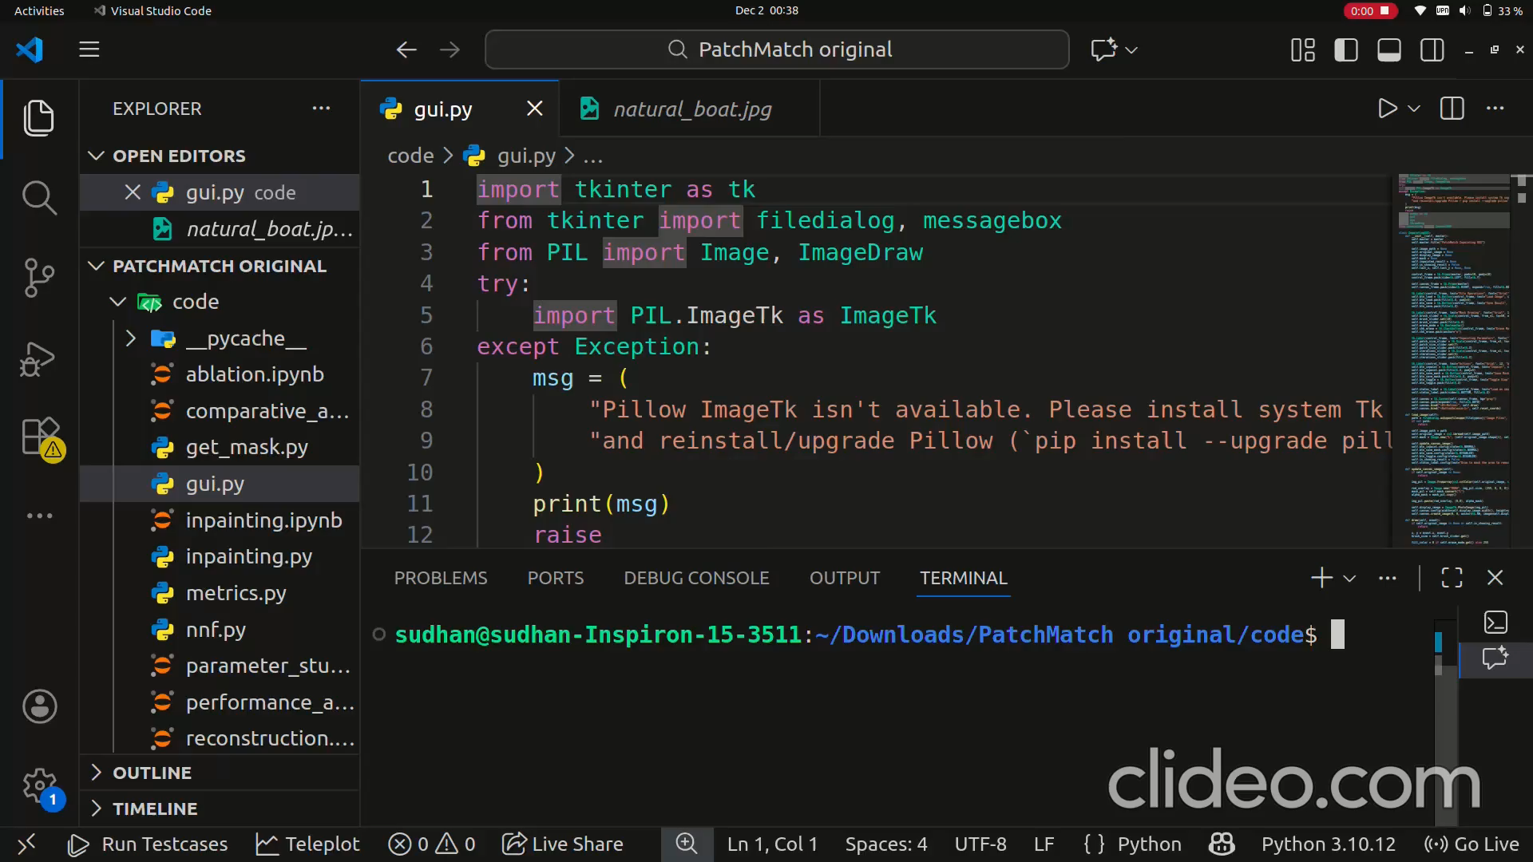

Slide 24
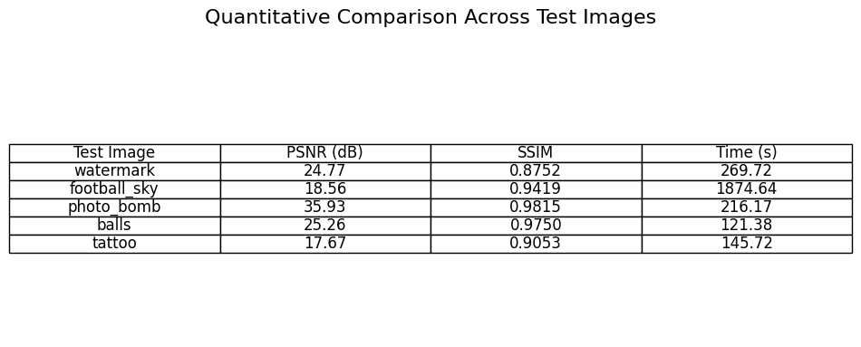
Comparision analysis

Slide 25
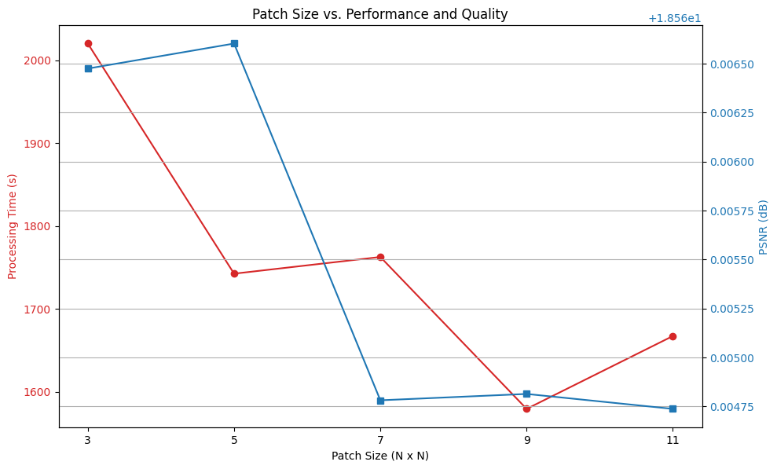
Parameter studies

Slide 26
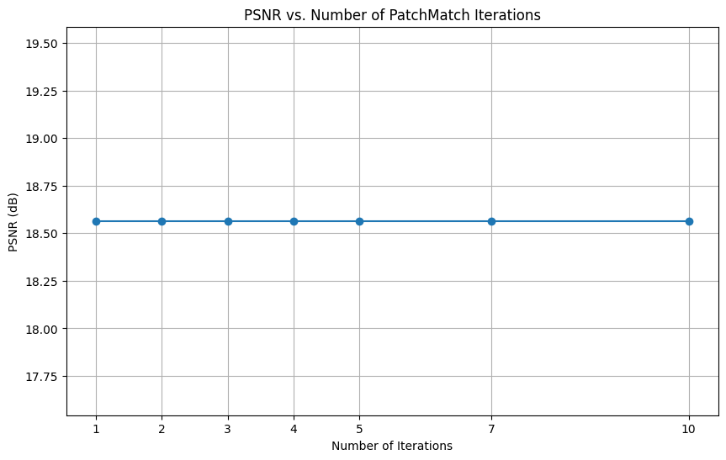
Parameter studies

Slide 27
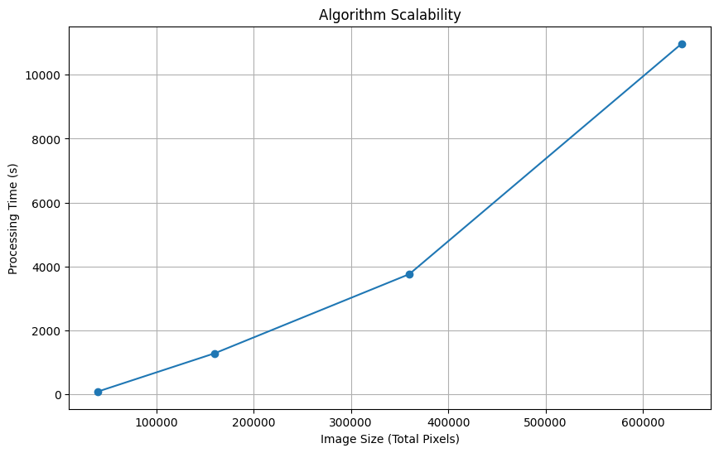
Performance analysis

Slide 28
THANK YOU

